Slide 1
Graduation Project 101
knowledge is power.

Slide 2
THE FOUR COMPONENTS
A research paper demonstrating research skills and writing skills, to be completed in the Junior year
A Service Learning Experience (SLE)/ product that demonstrates the use of knowledge and skills in a meaningful way to accomplish a goal, to be completed in the Senior year
An oral presentation, during which, students become a source of information communicating their project work before a review panel, to be completed in the Senior year
A portfolio to catalogue/document tasks, record reflective thinking and insights, as well as demonstrate responsibility for learning as work progresses through the entire process, to be kept throughout the process

Slide 3
THE RESEARCH PAPER
To be completed junior year
The research topic should be one that requires cumulative knowledge across grade levels and content areas.
The research topic should be one that is broad enough to allow the student access to enough information, yet narrow enough to make the research scope reasonable.
The research topic should be one in which the student is interested, but not one about which the student is already an expert.
The research topic should be one that is academically and creatively challenging to the student.
Primary research is a valuable component of any inquiry.
Students should use good judgment to be certain that the topics they choose are appropriate for presentation to a Review Board and the general public.

Slide 4
Research Paper Requirements
The research-based essay can be constructed from any genre, as specified by the English teacher, including but not limited to:
Expository, Compare and Contrast, Cause and Effect, Argumentative (Persuasive), Critical Review, Analytical, Literary
Each essay are approximately six to eight pages of text and must cite a minimum of five different sources. Encyclopedias and other general resources are not acceptable, including current, technological reference bundles. Students should strive for variety and balance in their selections.
The thesis statement should be in bold-faced type.
VIEW MORE INFORMATION AT: FORLANDENGLISH.WORDPRESS.COM

Slide 5
THE PRODUCT
The Service Learning Experience (SLE) consists of a minimum of fifteen hours of service related to the student's chosen community issue. The product must be student-generated and should include artifacts from the SLE that demonstrates the student's problem-solving skills.
The product is tangible evidence of the effort and time invested in the endeavor to meet the criteria established for the product:
extension of knowledge
application of knowledge & skills
synthesis of the research
service-based and practical in application
The product must be adequately documented with photographs, logs, letters, reflective journal entries, and other forms of documentation.

Slide 6
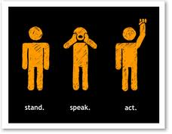
The Point of Academic Inquiry

Slide 7
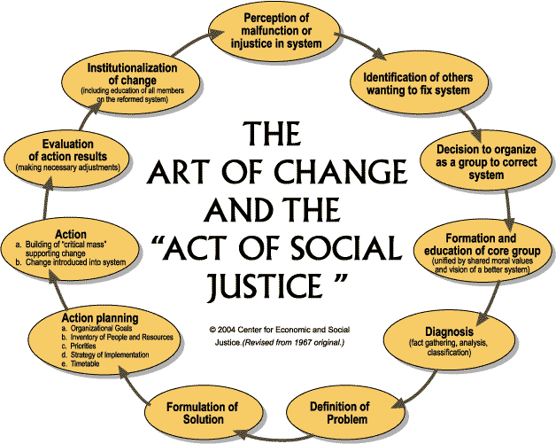

Slide 8
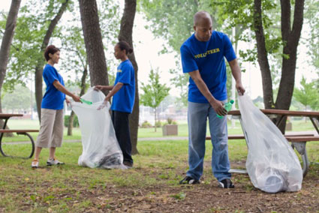
IMPROVE OR ALLEVIATE THE COMMUNITY ISSUE

Slide 9
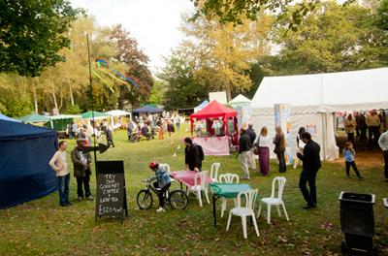
PLAN/HELP RUN A COMMUNITY EVENT RELATING TO YOUR RESEARCH

Slide 10
HELP CREATE OR OPERATE A COMMUNITY PROJECT

Slide 11
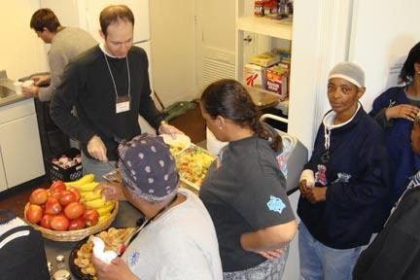
SERVE AT A LOCAL ORGANIZATION

Slide 12
CAPTURE THE ISSUE IN A COMPELLING WAY

Slide 13
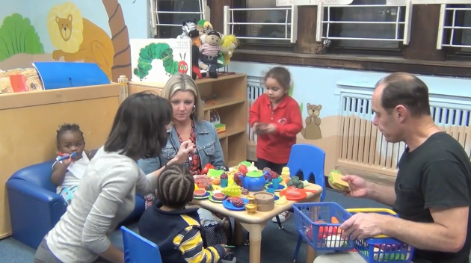
TEACH OTHERS ABOUT THE PROBLEM AND WHAT THEY CAN DO TO HELP

Slide 14
CREATE AND OPERATE A SOCIAL MEDIA CAMPAIGN TO BRING AWARENESS

Slide 15
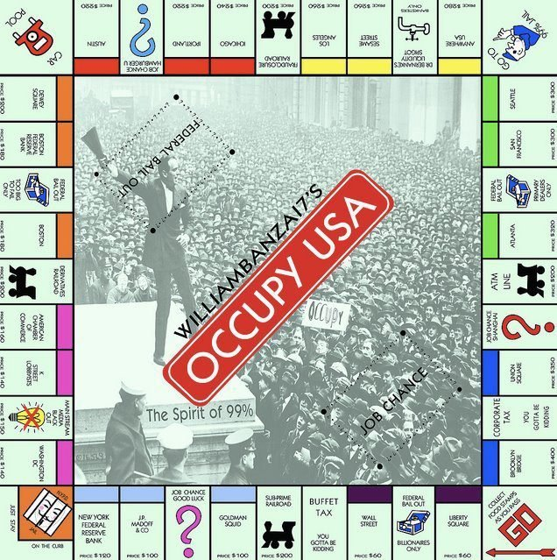
CREATE A GAME TO TEACH ABOUT THE TOPIC OR HELP PEOPLE EXPERIENCE YOUR ISSUE

Slide 16
USE MICRO-STORYTELLING OR PHOTO BLOGGING TO BRING AWARENESS & ACTIVE DISCUSSION

Slide 17
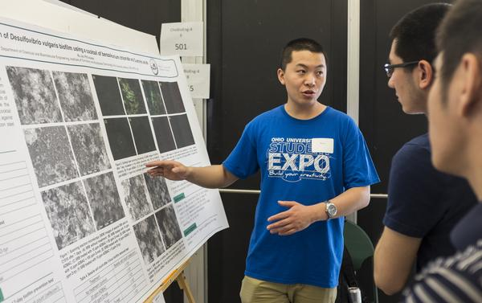
BE A LIAISON BETWEEN GROUPS TO FACILITATE UNDERSTANDING & CHANGE

Slide 18
WRITE AND PUBLISH WRITTEN ARTICLES, SHORT STORIES, POEMS ETC. GRAPPLING WITH THE ISSUE

Slide 19
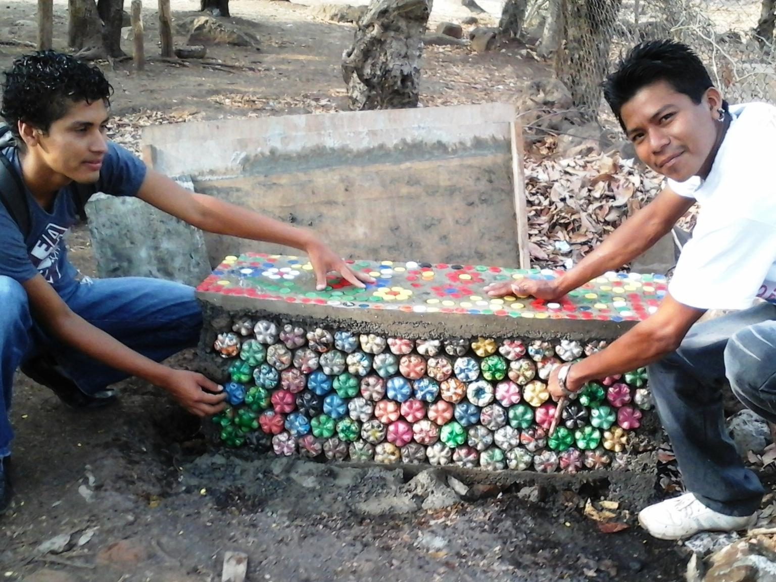
INVENT OR BUILD SOMETHING AN ORGANIZATION NEEDS

Slide 20
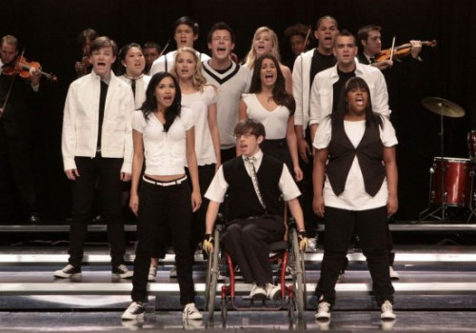
JOIN AN ARTS GROUP OR CREATE A PUBLIC ARTISTIC REPRESENTATION OF YOUR ISSUE

Slide 21
COMPLETE AN INTERNSHIP

